Slide 1
Data Science Process
The Team Data Science Process (TDSP) lifecycle is composed of five major stages that are executed iteratively.
These include:
1. Business Understanding
2. Data Acquisition and Understanding
3. Modeling
4. Deployment
5. Customer Acceptance
Source: Microsoft
Notes:
https://docs.microsoft.com/en-us/azure/machine-learning/team-data-science-process/
The Team Data Science Process (TDSP) provides a recommended lifecycle that you can use to structure the development of your data science projects. The lifecycle outlines the steps, from start to finish, that projects usually follow when they are executed. If you are using another data science lifecycle, such as CRISP-DM, KDD or your organization's own custom process, you can still use the task-based TDSP in the context of those development lifecycles. +
This lifecycle has been designed for data science projects that are intended to ship as part of intelligent applications. These applications deploy machine learning or artificial intelligence models for predictive analytics. Exploratory data science projects and ad hoc or on-off analytics projects can also benefit from using this process, but in such cases some steps described may not be needed.

Slide 2
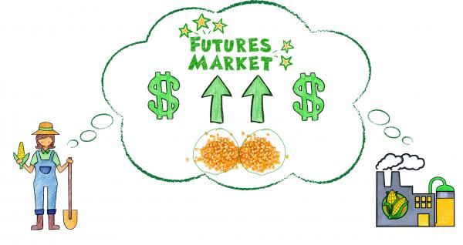
Business Understanding - Domain knowledge
Source: harvestpublicmedia
Producers and Consumers: All soybeans futures contracts require the traders to put up the initial margin and a maintenance margin and comes with contract expiry months.
Uses: It is widely used as livestock feed(specially in China hogs), a substitute for meat as well as a source of oil.
Supply and Demand:
U.S. (55%), Argentina, Brazil, China, and India - 90% Soybean production.
80% of soybean farming coming from the Midwest
Biggest Importer: China, Tariffs
Competitive Crops: Midwest agri- 75% of that area in corn and soybeans
Notes:
Soybean Futures - From <https://tradingsim.com/blog/6-things-you-must-know-about-soybean-futures-trading/>
https://www.harvestpublicmedia.org/post/watch-how-futures-market-helps-keep-your-grocery-bill-down
They're typically charged as a percentage of the transaction price that a buyer pays a foreign seller. In the United States, tariffs — also called duties or levies — are collected by Customs and Border Protection agents at 328 ports of entry across the country.

Slide 3
Data Exploration - Questionnaire
Price Differences by Contract:
There is multiple instances where difference of july-may inversely proportional to difference of May-mar prices.
High, Low and Close prices follows almost same trend as Closing price.
Seasonality:
Most of the times: Prices are going high during blooming and Harvesting Period (July to Oct)
Prices of Soybean futures have been dropping after 2016 Contracts (before Approx. 12.00), Nowadays, It stays below 11.20
Effect of Delayed Seeding: May, June and July are high volume seeding months and Contract rates are falling for those months wrt prior years.
Canola Price: It is not much related with soybean price.
Corn Prices/Trade Weighted U.S. Dollar Index - Inversely Correlated
Notes:
Answer Undergrad Questions:¶
What is the price difference by contract date?
Is there seasonality in the target variable for a given contract date?
Is canola price predictive of soybean price?
Is there an effect of the delayed 2019 seeding on soybean prices (see time lag in data sets on Oil Crops Outlook tab: oil crops chart gallery figure 1)?
Answer Grad questions:¶
5. Is there a lag between tweets related to agriculture and/or trade and the markets?
6. What are the most impact indicators to watch from the next top three soybean producing countries (Brazil, Argentina and China)?
7. What other data sources could you use as macroeconomic indicators, and what is their relative importance?

Slide 4
Data Preparation: Soybean Futures Prices
General
Daily Causal Factors
Trade-war and Tariffs (Trump tweets)
Seasonality – Planting, Blooming, Harvest (by Year)
Supply and Demand (Exports)
Market
Daily Causal Factors
Last Days Price
Volume Weighted Average Price
Percentage Change Per Day
Weather – Forest fire Brazil
Competitors – Brazil, Argentina
Widespread Disease (African swine fever, Asian rust)
News – Relevance, Sentiments and Magnitude
Trade Weighted U.S. Dollar Index
USD-Yuan Exchange Rate
Competitive Crops – Corn, Wheat

Slide 5
ML Pipeline
Data
Preparation
Feature Selection
Final Model
Model Training
Market data, News, Feature Engineering
Recursive Feature Elimination, High Correlation, Low Variance Filter
Various Model Evaluation
XGBosst, LSTM
Ensemble of Weak Learners
Model Selection based on performance

Slide 6
Sequence Forecasting - Training Process (Step X)
MODEL TRAINING
TRAINING
Training Set
(Beginning of the Time Series – 70% rows)
Machine Learning
LSTM, XGBoost, LightGBM
Raw Daily Time Series Data/Target
Number of rows
Feature Engineering
(vwap, eod, change)
Validation Set
(Middle of the Time Series – 10% rows)
HYPERPARAMETER TUNING
Test Set
(End of the Time Series – 20% rows)
PERFORMANCE EVALUATION
Ensemble Model
(Trained on Whole Data)
STEP X PREDICTION
Last Sequence from Dataset
Predict
Predicted Step X Sequence
[949.69, 943.44, 943.44]
[952.69]

Slide 7
Conclusion

Slide 8
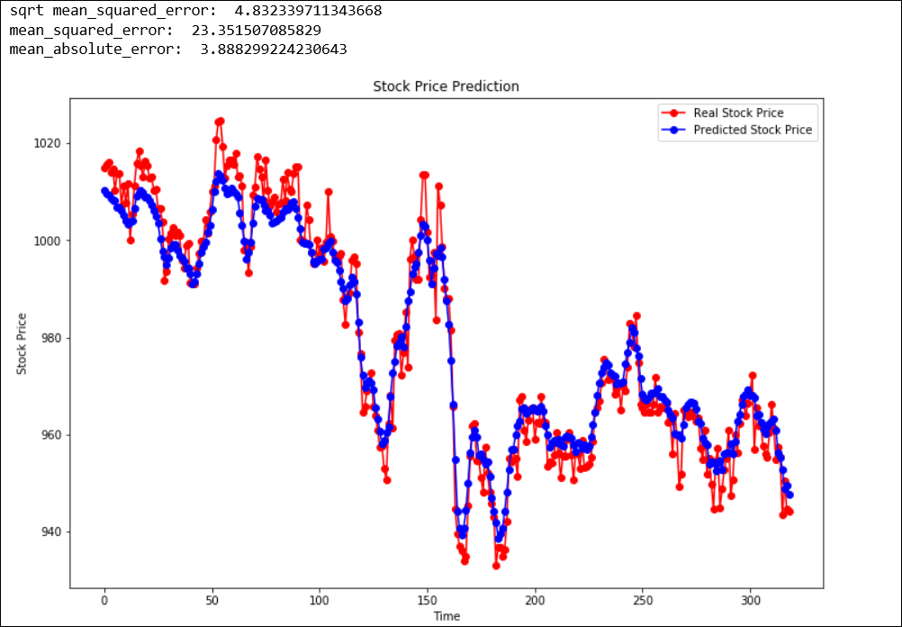
Results
ZSN20- Prediction on Next 300 days

